Slide 1
Lecture 9.1 Hiring: Signaling Quality

Slide 2
the recruitment process
A firm that is hiring needs to:
Weed out undesirable applicants
Attract the right types of applicants
Firms face a problem of adverse selection. Applicants know what type of person they are, but the firm doesn’t. Adverse selection is a problem of asymmetric information.
How to overcome this?
Use credentials: CVs – look at education, work experience etc. How costly was the credential to attain?
Screening: Screening tests are imperfect, and can take many forms:
Simple tests – but perhaps these can be gamed.
A probation period – but this might be costly for the firm.
Fixed term contracts

Slide 3
HIRING: SIGNALING QUALITY
Spence, M. (1973), Quarterly Journal of Economics, 87(3), pp. 355-374
Consider a firm seeking a productive worker. The firm’s production function is g(θ), where θ is the productivity of the worker.
productive workers: θ = H
unproductive workers: θ = L
A more productive worker produces more for the firm
g(H) > g(L), where H > L
Workers obtain an education to signal productivity. Timing of the game:
The worker chooses an education level, e.
The employer offers a wage, w.

Slide 4
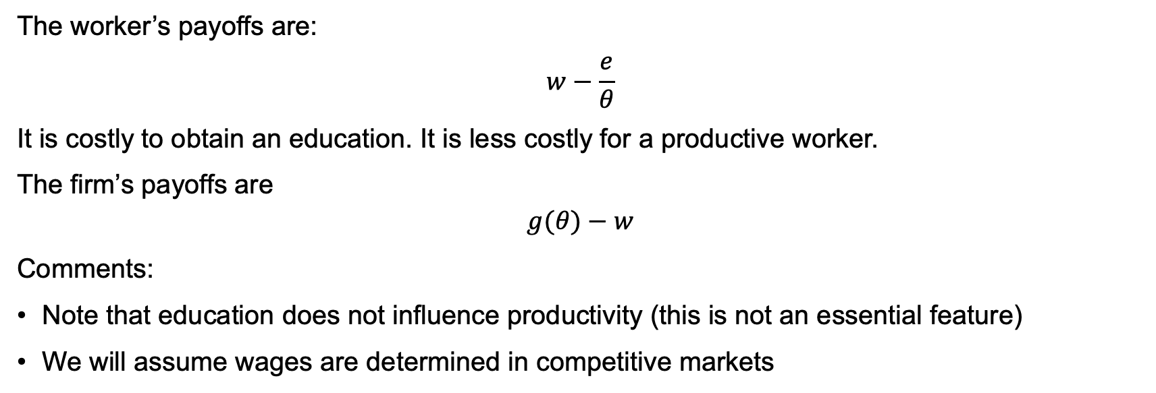
HIRING: SIGNALING QUALITY
The worker’s payoffs are:
$$w−\frac{e}{θ}$$
It is costly to obtain an education. It is less costly for a productive worker.
The firm’s payoffs are
$$g(θ)−w$$
Comments:
Note that education does not influence productivity (this is not an essential feature)
We will assume wages are determined in competitive markets

Slide 5
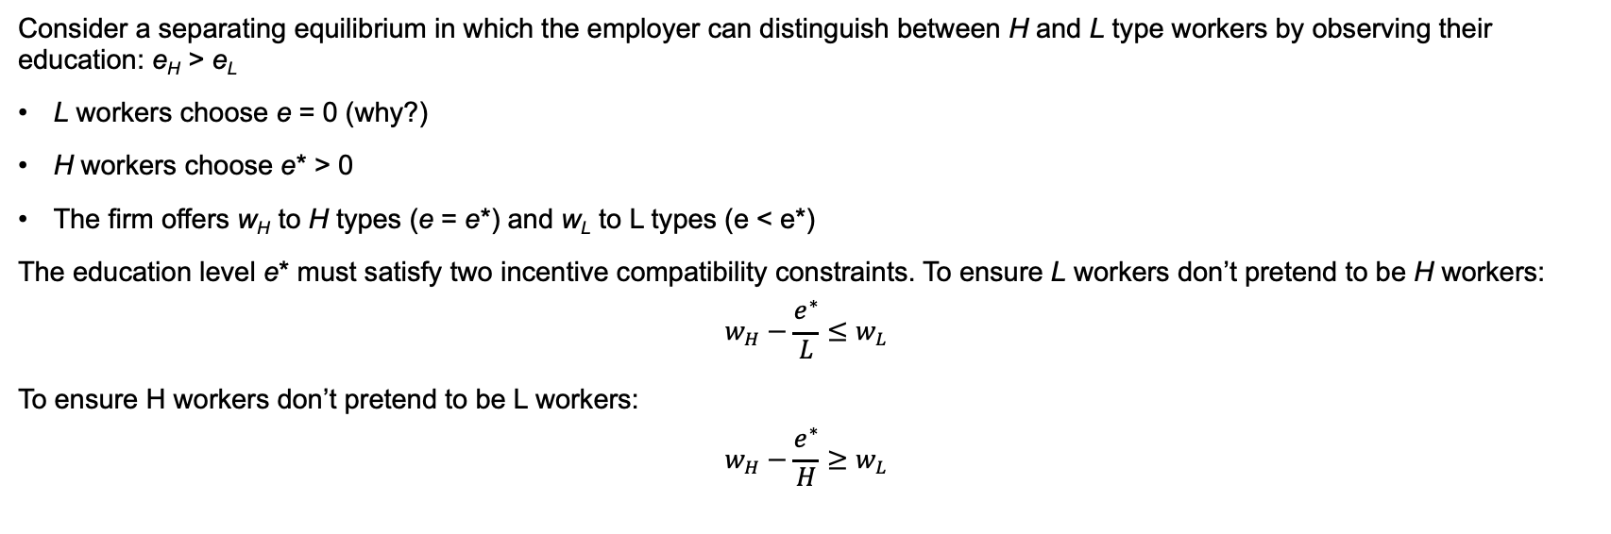
HIRING: SIGNAlING QUALITY
Consider a separating equilibrium in which the employer can distinguish between H and L type workers by observing their education: e_{H} > e_{L}
L workers choose e = 0 (why?)
H workers choose e* > 0
The firm offers w_{H} to H types (e = e*) and w_{L} to L types (e < e*)
The education level e* must satisfy two incentive compatibility constraints. To ensure L workers don’t pretend to be H workers:
$$w_{H}−\frac{e^{∗}}{L}≤w_{L}$$
To ensure H workers don’t pretend to be L workers:
$$w_{H}−\frac{e^{∗}}{H}≥w_{L}$$

Slide 6
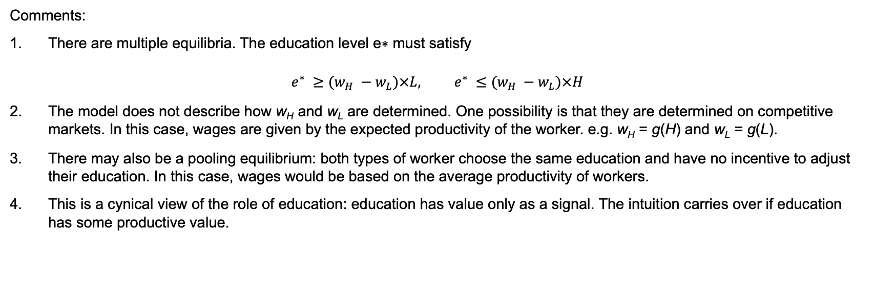
HIRING: SIGNAlING QUALITY
Comments:
There are multiple equilibria. The education level e∗ must satisfy
$$e^{∗} ≥(w_{H} −w_{L})×L, e^{∗} ≤(w_{H} −w_{L})×H$$
The model does not describe how w_{H} and w_{L} are determined. One possibility is that they are determined on competitive markets. In this case, wages are given by the expected productivity of the worker. e.g. w_{H} = g(H) and w_{L} = g(L).
There may also be a pooling equilibrium: both types of worker choose the same education and have no incentive to adjust their education. In this case, wages would be based on the average productivity of workers.
This is a cynical view of the role of education: education has value only as a signal. The intuition carries over if education has some productive value.

